Slide 1





Pytorchcode

Slide 2



data overview
47,000+ Rows
18 columns
Balanced Dataset
Train-Test Split:
80% train
20% test

Slide 3

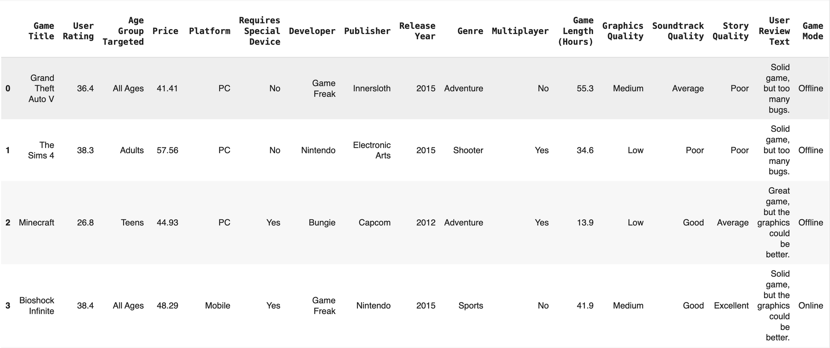
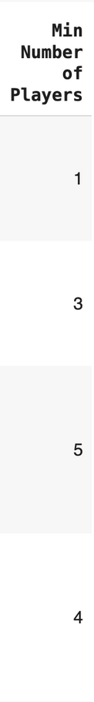
Snippet of Video Game Dataset
296-256 = 40
296 in binary is 100101000

Slide 4





Predition Flow
Raw Data ⟶ Data Cleaning ⟶ Embedding ⟶ Models ⟶ Prediction

Slide 5



WHat’s the goal?

Slide 6
WHat’s the goal?
Predict user ratings

Slide 7


Data cleaning
Predictive column: User Reviews
What’s used: Price, game length, soundtrack story and graphic quality.
What’s cut: game title, user review text

Slide 8
Identifying Column groups
Categorical columns:
Small categorical features:
Age Group Targeted
Requires Special Device
Multiplayer
Game Mode
Big Categorical Features:
Publisher
Genre
Platform
Developer
Target column:
User Rating (continuous output)
Numerical columns:
Price
Release year
Game Length (Hours)
Min number of players
Notes:
Speaker notes: number and categorical columns are separate because the catagorical columns need to be embedded, or changed into numbers so it can be used in the model

Slide 9
Neural Networks work best with numerical data, and categorical columns (like Publisher, Genre, etc.) need to be converted into numerical representations.
Why embedding?
Embeddings turn large, categorical data (like Platform or Publisher) into smaller, more manageable numbers, while keeping important relationships between them. This helps make the model simpler and more efficient.
Notes:
Speaker notes: number and categorical columns are separate because the catagorical columns need to be embedded, or changed into numbers so it can be used in the model

Slide 10
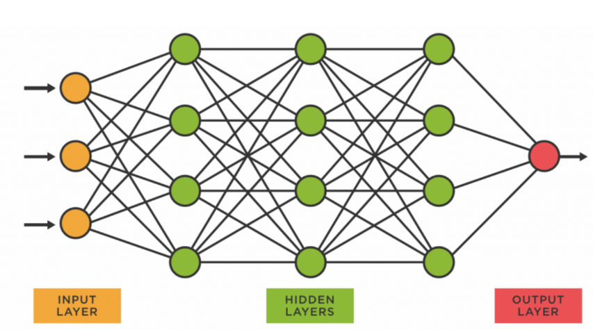
Notes:
Speaker notes: So our program takes in all this information, multiplies the weights and adds the bias, and gets some sort of output. Because it does this randomly for the first itteration this output is horrible. This is where epochs come in.

Slide 11
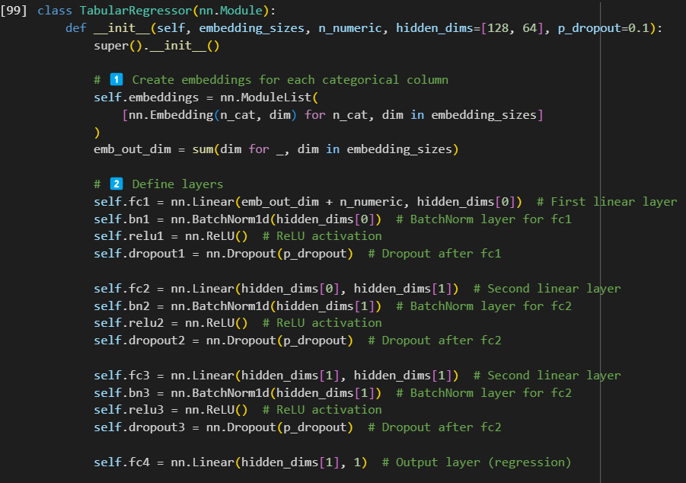
Binary Code Example: 101001100
Key Code
Notes:
Essentially the relu allows the program to understand complex relation ships, telling the program that positive values matter, and negative values don't, turning them to zeros, essentially turning them "off"

Slide 12
Binary Code Example: 101001100
Key Code
Notes:
Linear puts the data together
batch norm normalizes it to zero
Essentially the relu allows the program to understand complex relation ships, telling the program that positive values matter, and negative values don't, turning them to zeros, essentially turning them "off"
Dropout prevents overfitting
Each one of these code block equates to one of the layers in the neural network

Slide 13
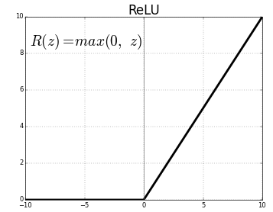
Binary Code Example: 101001100
Key Code
Notes:
Linear puts the data together
batch norm normalizes it to zero
Essentially the relu allows the program to understand complex relation ships, telling the program that positive values matter, and negative values don't, turning them to zeros, essentially turning them "off"
Dropout prevents overfitting
Each one of these code block equates to one of the layers in the neural network

Slide 14
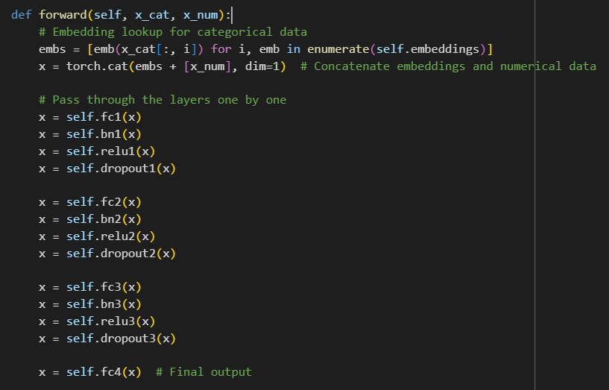
Key Code
Notes:
Linear puts the data together
batch norm normalizes it to zero
Essentially the relu allows the program to understand complex relation ships, telling the program that positive values matter, and negative values don't, turning them to zeros, essentially turning them "off"
Dropout prevents overfitting
Each one of these code block equates to one of the layers in the neural network

Slide 15
Notes:
Speaker notes: So our program takes in all this information, multiplies the weights and adds the bias, and gets some sort of output. Because it does this randomly for the first itteration this output is horrible. This is where epochs come in.

Slide 16
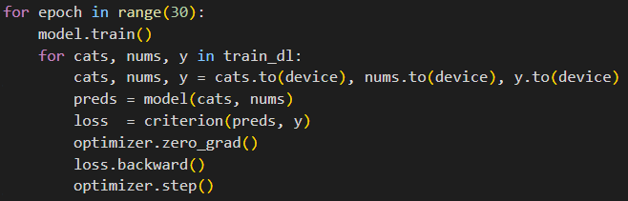
Epochs
Iterate this many times
Notes:
Speaker notes: number and categorical columns are separate because the catagorical columns need to be embedded, or changed into numbers so it can be used in the model

Slide 17
Epochs
Bringing the data together
Notes:
Speaker notes: number and categorical columns are separate because the catagorical columns need to be embedded, or changed into numbers so it can be used in the model

Slide 18
Epochs
Create Prediction
Notes:
Speaker notes: number and categorical columns are separate because the catagorical columns need to be embedded, or changed into numbers so it can be used in the model

Slide 19
Epochs
Calculate Loss
Notes:
Speaker notes: number and categorical columns are separate because the catagorical columns need to be embedded, or changed into numbers so it can be used in the model

Slide 20
Epochs
Optimize
Notes:
Speaker notes: number and categorical columns are separate because the catagorical columns need to be embedded, or changed into numbers so it can be used in the model
optimizer essentially tells the program how much it needs to move and in what direction

Slide 21
Epochs
Preforms backpropagation
Notes:
Speaker notes:
This line performs backpropagation, calculating the gradients of the loss with respect to the model's parameters. These gradients indicate how each parameter should be adjusted to reduce the loss.

Slide 22
Epochs
Updates model parameters
Notes:
Speaker notes:
This line performs backpropagation, calculating the gradients of the loss with respect to the model's parameters. These gradients indicate how each parameter should be adjusted to reduce the loss.
Hey this is what you need to change

Slide 23
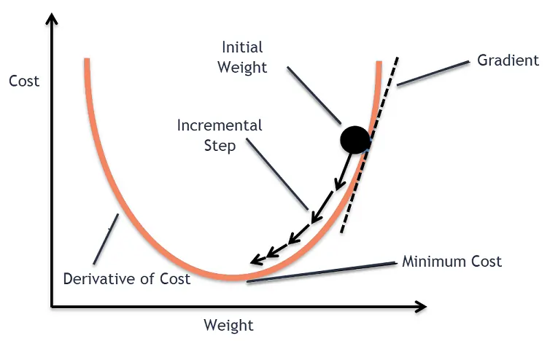
Optimizer
Notes:
Speaker notes: number and categorical columns are separate because the catagorical columns need to be embedded, or changed into numbers so it can be used in the model
optimizer essentially tells the program how much it needs to move and in what direction

Slide 24
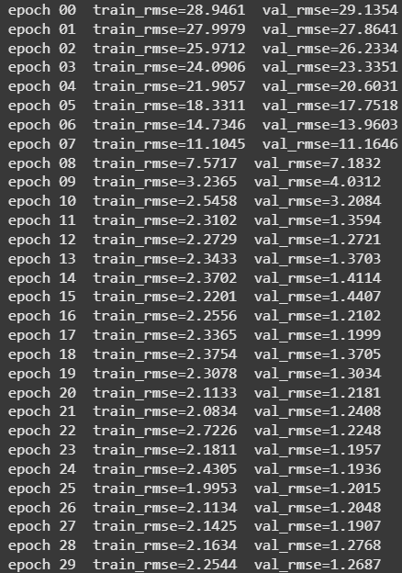

Epochs
Is this is good?
Notes:
Speaker notes: number and categorical columns are separate because the catagorical columns need to be embedded, or changed into numbers so it can be used in the model

Slide 25
Epochs
Is this is good?
Close but...
Notes:
Speaker notes: get rid og handicaps, or the dropoff and bn

Slide 26
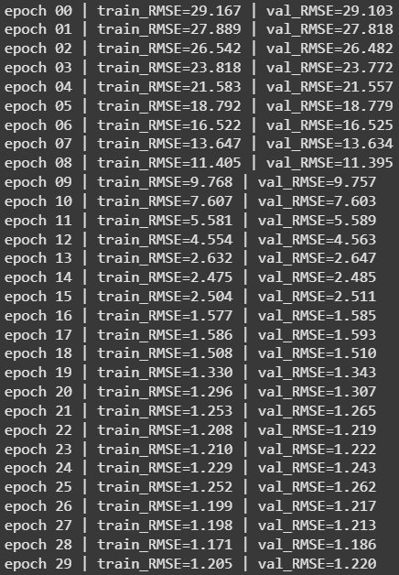
Epochs
This is good
Notes:
Speaker notes: “During training we deliberately add chaos—Batch Norm keeps re-balancing the signal and Dropout hides random neurons. When we test the model, we remove that chaos. The ‘real’ RMSE you care about is measured with everything stable and everyone singing, just like the model will behave in production.”

Slide 27
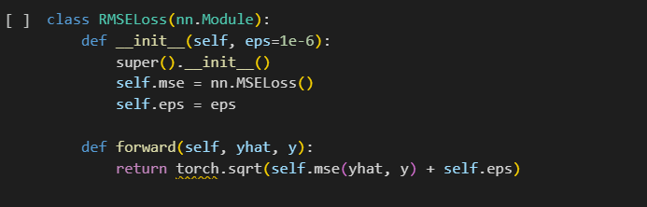

4.
Why RMSE?

Slide 28
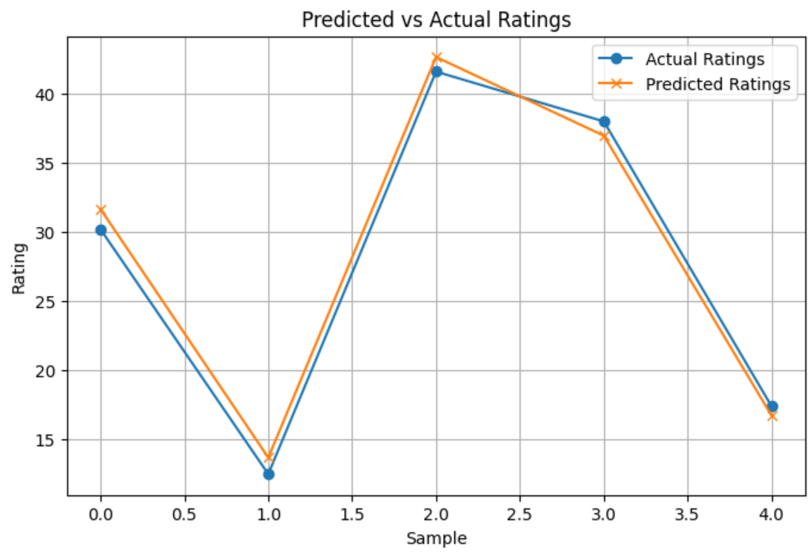
Root Mean Square Error visualize

Slide 29




COnclusion
The PyTorch neural network discovered hidden patterns and successfully learned to predict video game user ratings!
Key patterns it captured:
Publisher Influence: Some companies consistently affect ratings.
Genre Effects: Certain genres trend higher or lower.
Release Year Trends: Older and newer games show distinct patterns.
Other Features: Price, game length, and quality scores (graphics, soundtrack, story) matter too.
Final results:
Training RMSE: ~1.2
Validation RMSE: ~1.2
(Starting from RMSE > 28!)
Training involved:
Data Cleaning: Removing irrelevant fields.
Feature Engineering: Organizing numerical and categorical inputs.
Embedding Layers: Efficiently encoding large categories.
Model Training: 30 epochs with steady improvement.
Loss Function: RMSE for clear, interpretable accuracy.
A custom RMSELoss class stabilized training, and the Predicted vs. Actual plot confirmed tight, consistent predictions.

